Slide 1
Stock Market Prediction
Saad Ziaul Hasan
13101265
Mashrur Ahmad Khan
13101240
Al Faysal Bin Asad
13101095
Sadman Sakib Ador
13101134

Slide 2


Dataset Analysis
– Sadman Sakib Ador
Algorithm Analysis
– Al Faysal Bin Asad
Coding and Environment Setup &
Presentation making
– Saad Ziaul Hasan
Result Analysis, and Report writing
– Mashrur Ahmad Khan
Contributions

Slide 3

A Stock market or equity market is a market for the trading of company stock
(Shares) and derivatives at an agreed price.
What is Stock Market ?

Slide 4
Machine learning is an application of artificial intelligence (AI) that provides
systems the ability to automatically learn and improve from the experience.
What is Machine Learning?

Slide 5


First, we perform adaptive filtering of the raw price data.
Then we feed filtered data
Then we perform predictions
Prepare the recommendations using those predictions
This project will focus exclusively on predicting the daily trend
Goals

Slide 6
Predicting Google’s stock price using various regression techniques. Toy example for
learning how to combine numpy, scikit-learn and matplotlib. Can be extended to be more
advanced.
File - saad.csv data set used to train the model.
Data Analysis

Slide 7
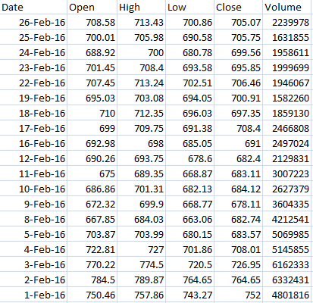
A Screen shot of our ( saad.csv ) data set
Data Analysis

Slide 8

Algorithms Used
Linear regression model
The generated linear
This is a Stock Market Prediction project where we use Python 3.5 and a SciKit and
a linear regression model to it. Then we plot a graph of the underlying data set, as
well as the generated linear model. Once these models have been trained they
could be used to predict a value for the future.

Slide 9
Algorithms Used
The linear regression line doesn’t actually go through the center of
each price dot point.
In fact, some price bars are quite far away from the line.
Traders usually view the Linear Regression Line as the fair value price for the
future stock.
When prices deviate above or below, traders may
expect prices to go back towards
the Linear Regression Line.

Slide 10

Resources are available in Internet, found similar Git hub code.
Library: Numpy, Sklearn, Matplotlib, Python 3.5
Explanation about code

Slide 11

Covered
Data Mining
Data Analytics
Prediction of the daily trend
Runnable the project
Risk factor analysis

Slide 12

References
শেয়ারবাজারের কলাকৌশল - ড. ইফতেখারুল মোবিন
https://github.com/chaitjo/regression-stock-prediction
http://beancoder.com/linear-regression-stock-prediction

